Slide 1


Slide 2

Celebrating Success
-Apprenticeships
Apprenticeship placements (Blackfen students):
Traditions
Unilever
Home Office
Warner Bros HR
Ministry of Justice
Bond Byron Architects
Aspect Capital
Horwich Farelly Law Firm
Frank Hirth UK Tax Advisory
Lambeth Council
Met Police
CMS Level 7 (Solicitor Apprenticeship)

Slide 3


Slide 4

An Apprenticeship helps you get ahead with.....
Job
Pay
Training
New Skills
Experience
Qualifications
Notes:
You will be an employed member of staff and will:
Have a contract of employment – fixed term or permanent
Be paid and get paid holidays
Be trained and gain qualifications
Earn more as you become more experienced, skilled and knowledgeable
Work alongside experienced and skilled people

Slide 5
Average salary for an apprentice 2024
£21,651
The current minimum apprenticeship wage is £6.40 per hour.
Average salary for a degree apprenticeship 2024
£24,340

Slide 6
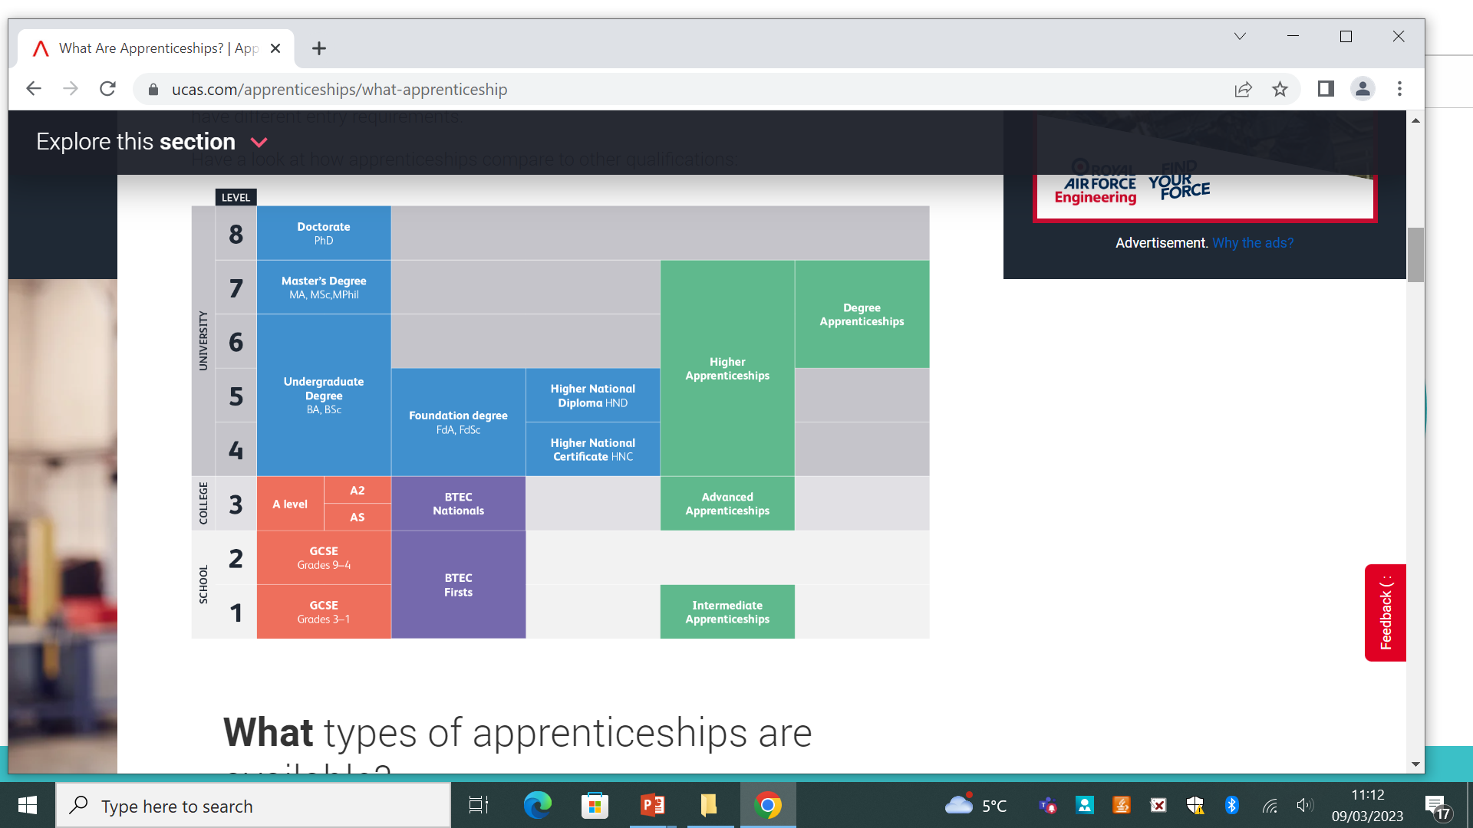

Slide 7
Apprenticeships
After completing your level 3 courses, ideally you should be looking at a Level 4 ‘Higher’ apprenticeship.
You should only consider level 3 if it is in a specific area where you have little or no experience eg Engineering
Notes:
Speakers notes:
Can you guess who the following people are and what they started their career as?
(Allow the class to call out some answers)
Answers (Left to right)
Jamie Oliver (Chef, author and TV personality) started helping out at his parents pub before completing an Apprenticeship in catering
Sir Alex Ferguson (Football coach) started as an Apprentice toolmaker in the shipyards in Glasgow
Billy Connolly (comedian) also started out as a welder in the same Glasgow shipyard as Sir Alex Ferguson
Elvis Presley (singer and film star) started out as an apprentice plumber
Rebecca Addlington OBE (Olympic gold medal swimmer) completed an Advanced Apprenticeship in Sporting Excellence
Alan Titchmarsh started as an apprentice gardener with Ilkley Council and completed a City and Guilds qualification in horticulture before moving to Kew Gardens to study a diploma in Horticulture

Slide 8
Apprentices are employed and paid a wage throughout the course.
Apprentices will gain a head start in their chosen profession.
Training costs are co-funded by the government and the employer
Apprentices are assessed at the end of the apprenticeship term
Many apprentices are kept on after their apprenticeship

Slide 9
Apprenticeships…you need to consider this…
It’s a real job, you have to be there on time and do what’s expected of you!
Working and studying on the job can be tough
Although there are chances to socialise and meet new people. It won’t be like going to university!
You’ll get paid….however you will also pay tax and National Insurance

Slide 10
Applying for an apprenticeship
As an apprenticeship is a job, you apply directly through the employer
You will need to submit a CV/letter of application
There will be an interview
There may be an assessment to complete

Slide 11
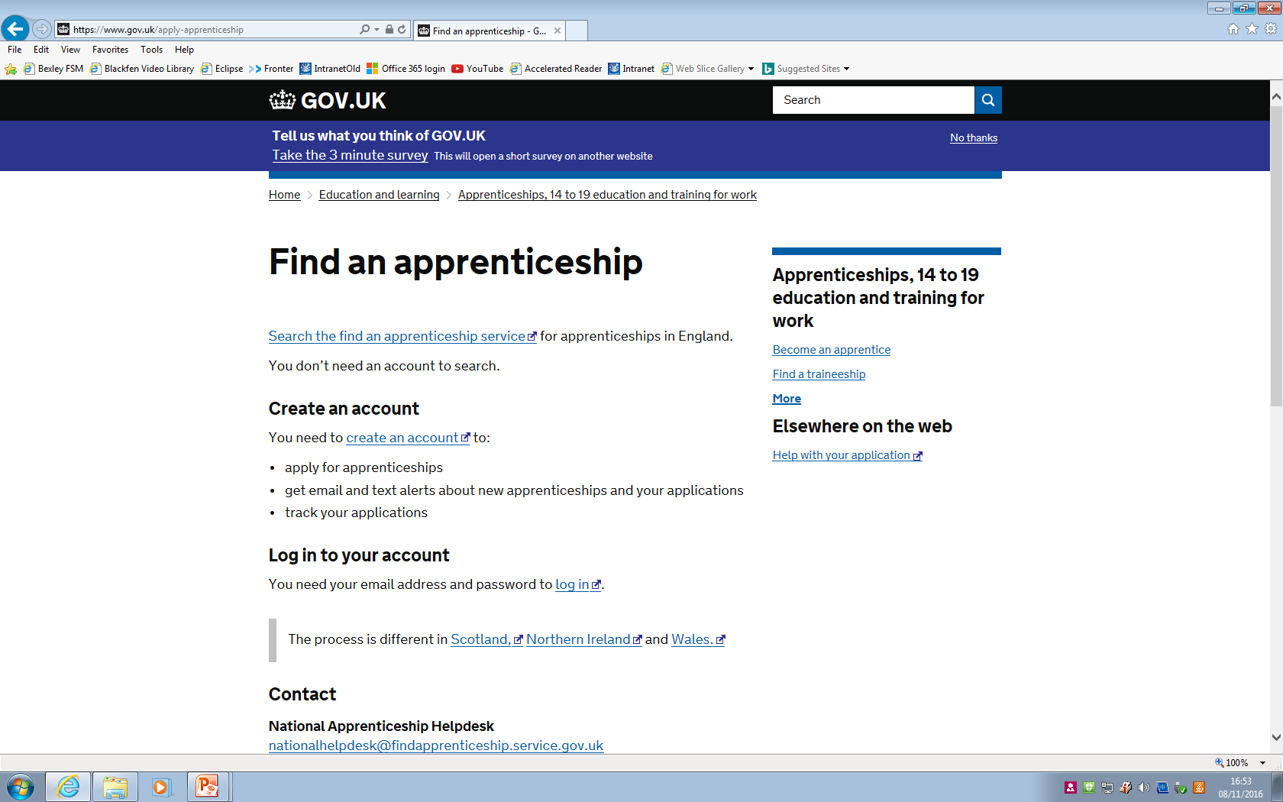
How to apply for an apprenticeship
www.gov.uk/apply-apprenticeship
Notes:
Speaker notes:
Due to demand from business and backing from the government Higher Apprenticeships are expanding. Apprentices’ opportunities for career progression are increasing with the expansion of Higher Apprenticeships (levels 4-7). Equivalent to a degree, more of these specialised and highly skilled Apprenticeships are being offered each year, giving individuals the chance to continue their professional development and realise their full potential.

Slide 12

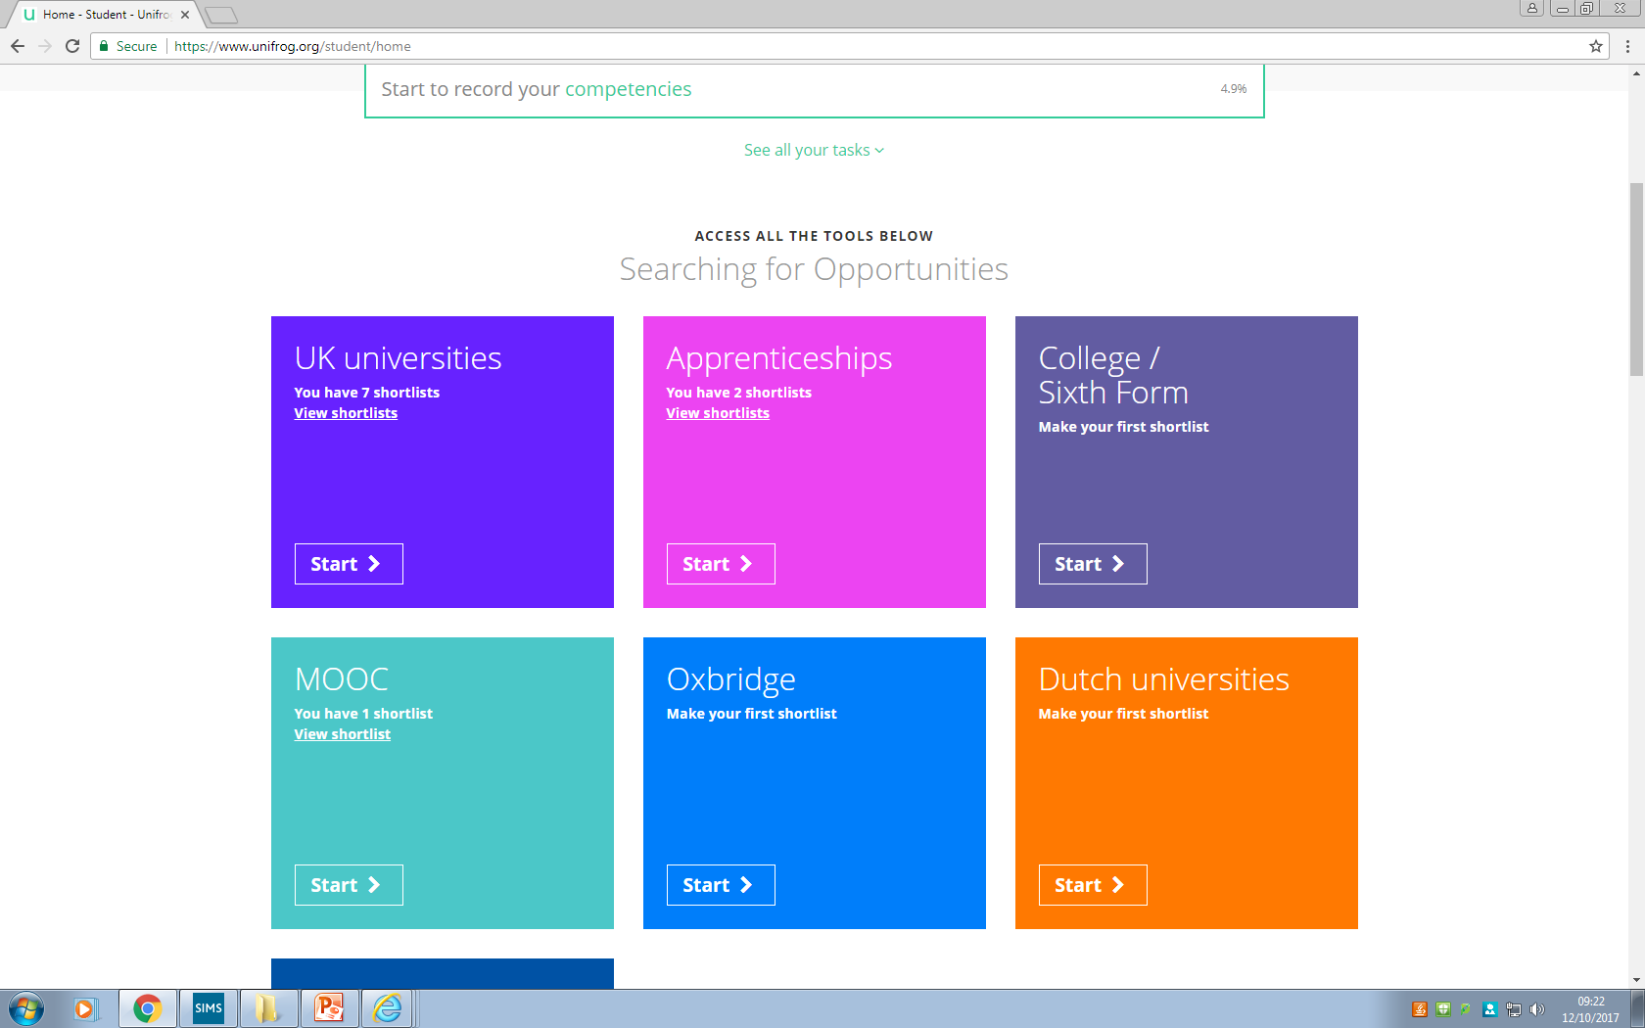
How to apply for an apprenticeship
Search for apprenticeships using Unifrog
https://www.unifrog.org/student/apprenticeships/start
Notes:
Speaker notes:
Due to demand from business and backing from the government Higher Apprenticeships are expanding. Apprentices’ opportunities for career progression are increasing with the expansion of Higher Apprenticeships (levels 4-7). Equivalent to a degree, more of these specialised and highly skilled Apprenticeships are being offered each year, giving individuals the chance to continue their professional development and realise their full potential.

Slide 13
https://www.amazingapprenticeships.com/higher-degree-listing/?utm_source=homepage+banner&utm_medium=h%26d+jan&utm_campaign=naw2025

Slide 14


Slide 15
Tips for applying for an apprenticeship
Investigate now – look at possibilities this year (use Unifrog, UCAS Hub, Pathways CTM, Amazing Apprenticeships)
Get your CV up to date (CV builder Unifrog)
Take up opportunities to build up your CV
Undertake work experience (inc. Virtual)
Apply early
Get interview experience
Attend Insight days
Strive for best grades in your A Level/BTEC qualifications

