Slide 1


Year 10 Information Evening

Slide 2

Key Stage 4
Building breadth & balance

Slide 3

Key Stage 4
Building breadth & balance

Slide 4

Your work is going to fill a large part of your life, and the only way to be truly satisfied is to do what you believe is great work. And the only way to do great work is to love what you do. If you haven't found it yet, keep looking. Don't settle. As with all matters of the heart, you'll know when you find it.
Steve Jobs
Mrs. Smith: Work Experience Coordinator and Red SSO

Slide 5
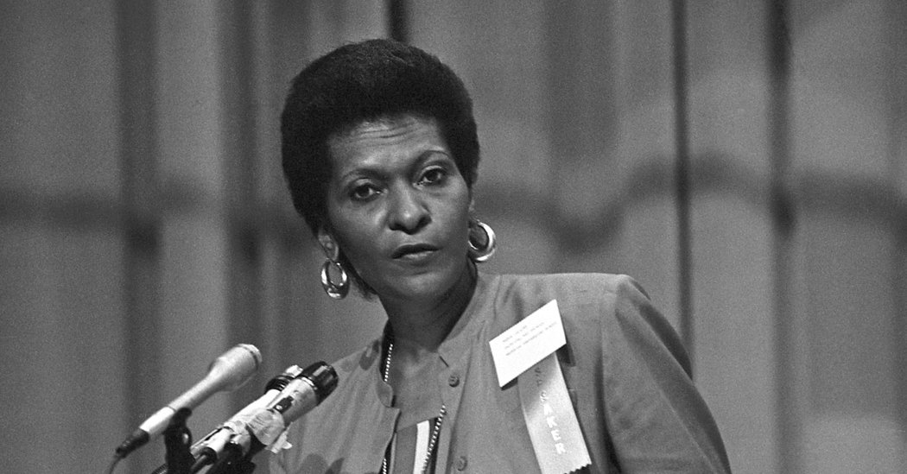
“If you don't give anything, don't expect anything. Success is not coming to you; you must come to it.“
Marva Collins.
Mr. Shaw: Raising Attainment Key Stage 4

Slide 6
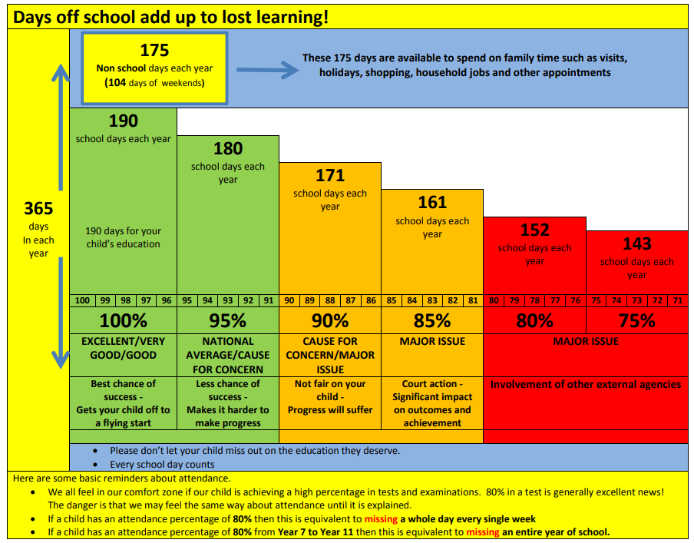
Notes:
RSH

Slide 7
What we do
Progress Updates
Raising Attainment Programme
Form Tutor raising attainment meeting/ @success action plan
Subject coaching
Intervention
General assistance

Slide 8
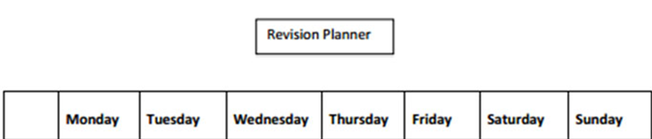

Study Habits….Top Tips: Homework and Revision
GCSE test how well you can remember the content not how well you understand it
2 hrs of work per night in Year 10
1 hr should be directed homework and 1 hour should be independent review and revision
Students should decide which 2 subjects they are revising nightly, develop a plan, stick to:
Notes:
RSH
Build the routines into your day

Slide 9
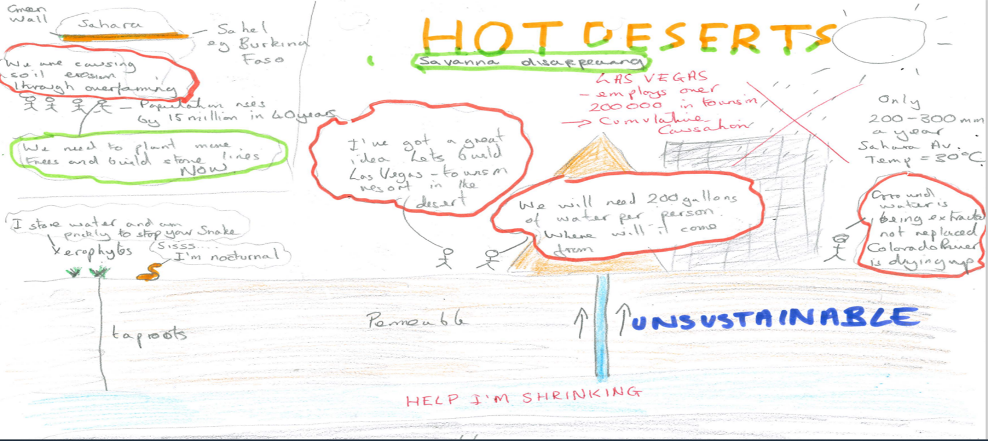
Top Tips: Revision Techniques
Students need the content in their long term memories. Regular reviewing, thinking/ adaptation techniques and testing can achieve this.
Infographics where students convert content into pictures and cartoons is a great way to reduce content and learn (1 topic content)

Slide 10
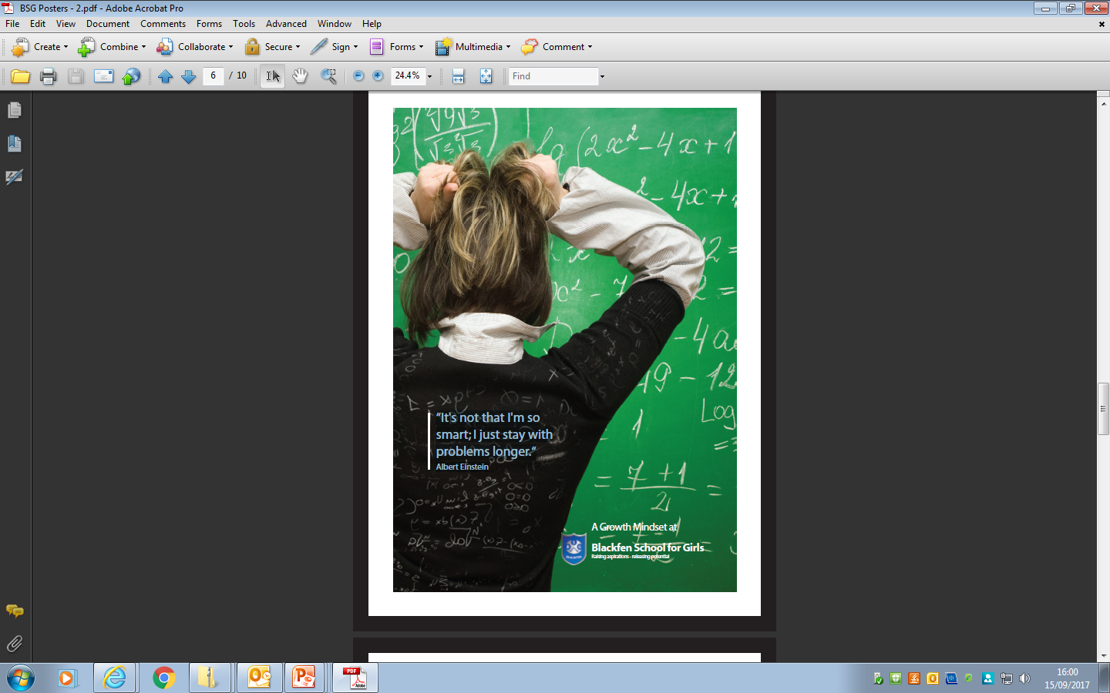
“It's not that I'm so smart; I just stay with problems longer.”
Albert Einstein
Madiha Mohammed- Year 11 Student

Slide 11
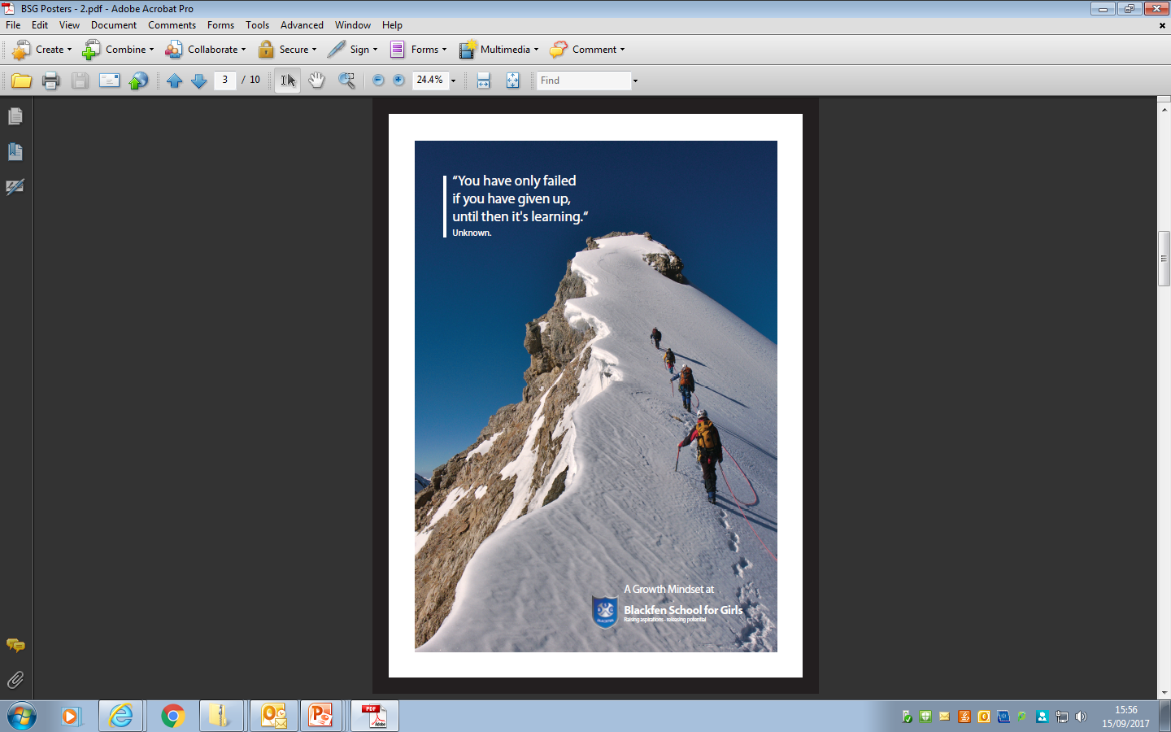
“You have only failed if you have given up, until then it's learning.”
Authur Unknown.
Ms. Hoad Assistant Head

Slide 12
Expectations
Attending every day on time
Following the Behaviour Charter
Focused and hardworking- key websites
Completing homework & Meeting deadlines
Organisation & Key dates –
Seek help if required

Slide 13
You have always been and will continue to be your child’s most important teacher.
Notes:
The campaign for academic success has found that parental support is 8 times more important in determining a child’s than any other factor.

Slide 14

“Nothing is impossible, the word itself says 'I'm possible.'” – Audrey Hepburn
Mrs Magrowski – Assistant Headteacher
Notes:
The campaign for academic success has found that parental support is 8 times more improtant in determining a child’s than any other factor.

Slide 15
“Hard work beats talent when talent fails to work hard.“
Kevin Durant.
Mr. Neil. Assistant Head teacher

Slide 16

Top Tips : Study Space and phones
a designated place to study
Phones should not be used during designated revision time as they distract and prevent concentration

